Slide 1
Lecture 4
System Analysis
and Design

Slide 2
Chapter 3
_{The Role of the}
_{System Analyst}
Chapter 3
SP

Slide 3
The Role of the System Analyst
What does it take to do systems analysis?
To effectively carry out system analysis an analyst must possess various skills.
The required skills can be divided into two categories, and both of them are required for system development:
Interpersonal Skills
Technical Skills
Chapter 3
SP

Slide 4
Required skills of System Analyst
Interpersonal Skills
Interpersonal Skills deal with relationships and the interface of the analyst with people in business or any other area of work.
Technical Skills
Technical Skills, on the other hand, focus on procedures and techniques for operations analysis, systems analysis, and computer science.
Chapter 3
SP

Slide 5
Interpersonal Skills
Interpersonal Skills relevant to systems work include the following:
Communication
Understanding
Teaching
Selling
Chapter 3
SP

Slide 6
Technical Skills
Technical Skills relevant to systems work include the following:
Creativity
Problem Solving
Project Management
Dynamic Interface
Questioning attitude and inquiring mind
Knowledge of the basics of computer and business function
Chapter 3
SP

Slide 7
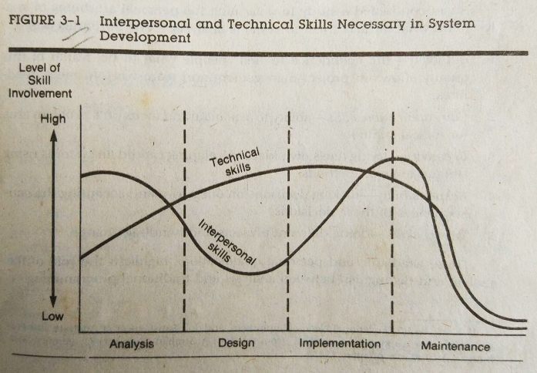
Interpersonal vs. Technical Skills
Chapter 3
SP

Slide 8
Academic Qualifications
The background and experience of analysts include:
A background in systems theory and organization behavior.
Familiarity with the makeup and inner workings of major application areas.
Competence in system tools and methodologies
A practical knowledge of 1 or more programming & database language.
Experience in hardware and software specifications.
Chapter 3
SP

Slide 9
Personal Qualifications
Awad conducted a study to determine the personal attributes of analysts and what attracts them to system analysis. The attributes are:
Authority
Communication skills
Creativity
Responsibility
Varies skills
Chapter 3
SP

Slide 10
The Multifaceted Role of the Analyst
The roles an analyst performs are:
Change agent
Investigator and monitor
Architect
Psychologist
Salesperson
Motivator
Politician
Chapter 3
SP

Slide 11
The Analyst/User Difference
An important aspect of system development is a viable interface between the analyst and the user.
Behavioral Issues
User Motivation
Analyst/User Difference
The Political Factor
Conflict Resolution
Chapter 3
SP

